Slide 1

DIGITAL ELECTRONICS
IV Semester ECE
Dr. Ranjita Rout
DEPARTMENT OF ELECTRONICS AND COMMUNICATION ENGINEERING
SCHOOL OF ENGINEERING & TECHNOLOGY
GIET UNIVERSITY, GUNUPUR, ODISHA

Slide 2
Code Converters,
Multiplexers; De-multiplexers;
Binary Multiplier,
Decoders; Encoders;

Slide 3
Code Converters
A code converter is a logic circuit that converts the inputs from one code and to another code as its outputs.
Ex: Binary to Gray code
Gray to Bianry code

Slide 4
Design of a 4-bit Binary-to-Gray Code Converter.
The input to the 4-bit binary-to-Gray code converter circuit is a 4-bit binary and the output is a 4-bit Gray code. There are 16 possible combinations of 4-bit binary input and all of them are valid. Hence no don’t cares.
The 4-bit binary code and the corresponding output Gray code are shown in the conversion table.

Slide 5
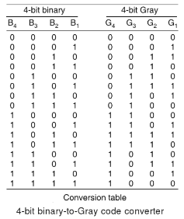

Slide 6

From the conversion table, we observe that expressions for the outputs G₄, G₃, G₂, and G₁ are as follows:

Slide 7
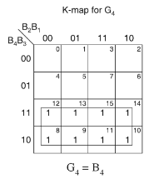
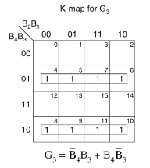

Slide 8
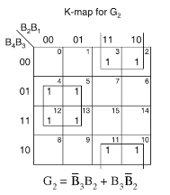
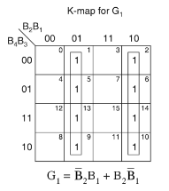

Slide 9

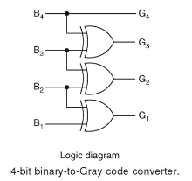
The minimal expressions for the outputs obtained from the K-map are:

Slide 10
Design of a 4-bit Gray-to-Binary Code Converter.
The input to the 4-bit Gray-to-binary code converter circuit is a 4-bit Gray and the output is a 4-bit binary code. There are 16 possible combinations of 4-bit Gray input and all of them are valid. Hence no don’t cares.
The 4-bit Gray code and the corresponding output binary code are shown in the conversion table.

Slide 11
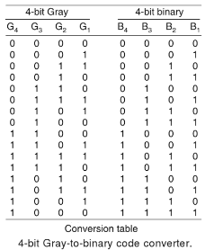

Slide 12

From the conversion table, we observe that expressions for the outputs B₄, B₃, B₂, and B₁ are as follows:

Slide 13
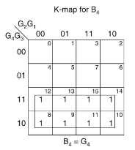
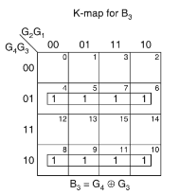


Slide 14
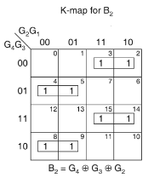
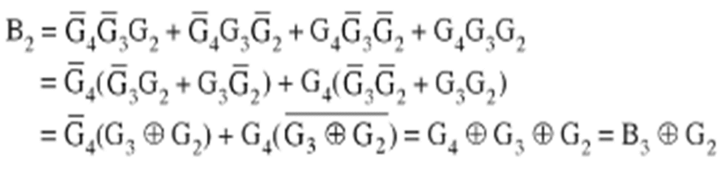

Slide 15
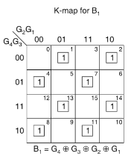

Slide 16
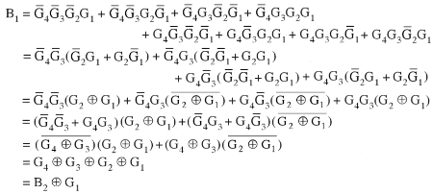

Slide 17

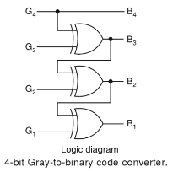

Slide 18
Multiplexers
A multiplexer, also referred to as MUX.
It is a combination logic circuit that is designed to accept multiple input signals and converts into a single output.
The selection of a particular input line is controlled by a set of selection lines.
Normally, there are 2^{n} input lines and n selection lines whose bit combinations determine which input is selected.

Slide 19
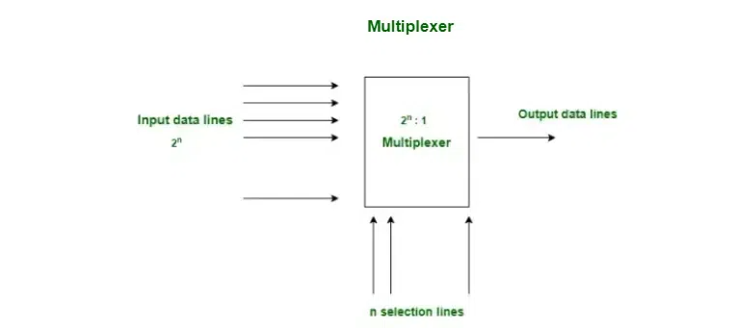

Slide 20

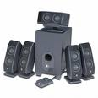
Typical Application of a MUX
Multiple Sources
Selector
Single Destination
MP3 Player
Docking Station
D₀
D₁
D₂
D₃
Laptop
Sound Card
MUX
Y
Surround Sound System
Digital
Satellite
S₁ | S₀ | Selected Source
0 | 0 | MP3
0 | 1 | Laptop
1 | 0 | Satellite
1 | 1 | Cable TV
Digital
Cable TV
Notes:
This slide shows a typical application of a multiplexer (in this case a 4-to-1 MUX). Have the students share other common applications of MUXs.
http://images.tigerdirect.ca/skuimages/large/Logitech-X-540-L23-7250-mai.jpg

Slide 21
Types of Multiplexers
Based on input data lines and select lines, the multiplexer can be of several types.
2×1 Multiplexer
4×1 Multiplexer
8×1 Multiplexer
16×1 Multiplexer etc.

Slide 22
2×1 Multiplexer
The block diagram of a 2×1 multiplexer is shown in the below Figure .
The 2×1 multiplexer is basic two input multiplexer which has two data input lines designated as I₀ and I₁, one data select line denoted by S and one output line denoted by Y.

Slide 23
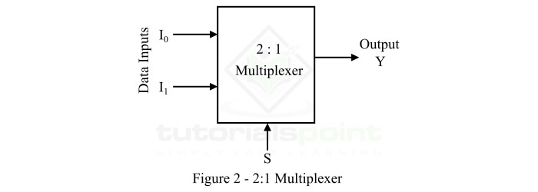
In the 2×1 multiplexer, the logic level of the digital signal applied to the select line S determines which data input will pass through the output line.
The operation of the 2×1 multiplexer can be understood from the following truth table.

Slide 24
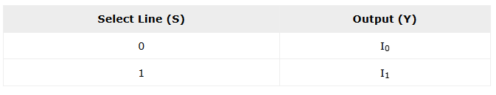
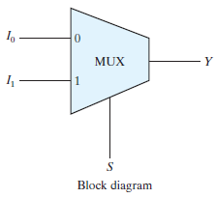
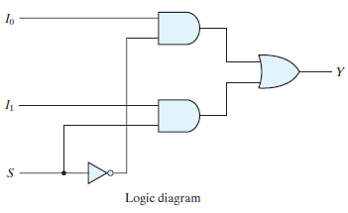
The expression of 2×1 multiplexer
Y = I₀.S’ + I₁.S

Slide 25
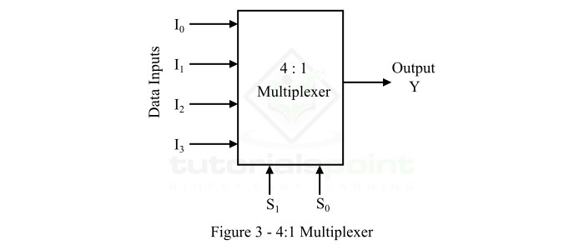
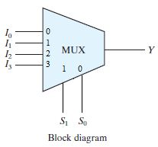
4×1 Multiplexer
4×1 Multiplexer has four data inputs I₃, I₂, I₁ & I₀, two selection lines s₁ & s₀ and one output Y.
The block diagram of 4×1 Multiplexer is shown in the following figure.

Slide 26
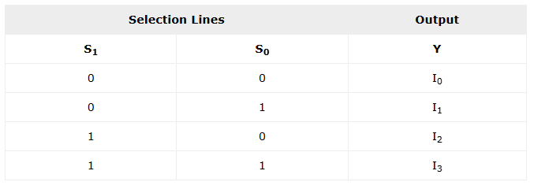

One of these 4 inputs will be connected to the output based on the combination of inputs present at these two selection lines. Truth table of 4×1 Multiplexer is shown below.
From Truth table, we can directly write the Boolean function for output, Y as

Slide 27
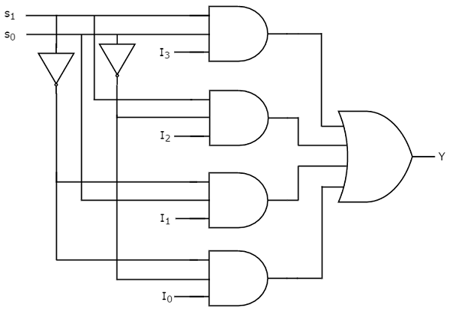
circuit diagram of 4×1 multiplexer

Slide 28
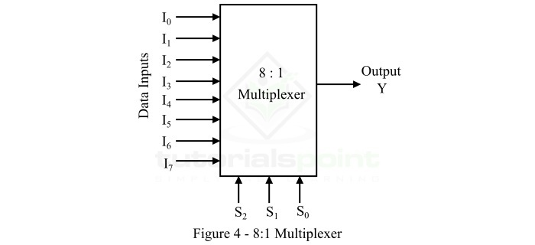
8×1 Multiplexer
8×1 Multiplexer has eight data inputs I₇ to I₀, three selection lines s₂, s₁ & s0 and one output Y.

Slide 29
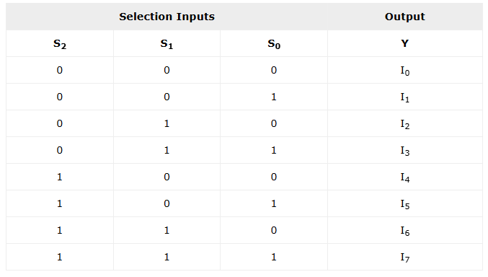
The Truth table of 8×1 Multiplexer is shown below.

Slide 30
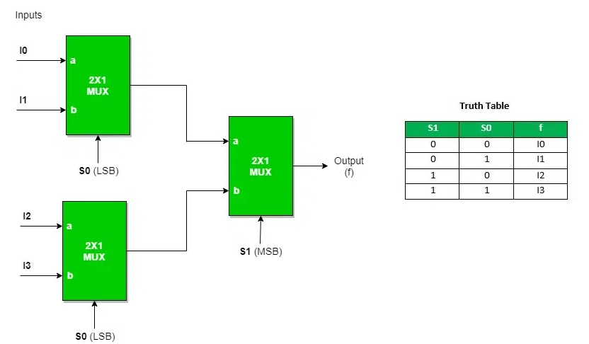
Implementation of Higher Order MUX using Lower Order MUX
4 : 1 MUX using 2 : 1 MUX : Three 2: 1 MUX are required to implement 4 : 1 MUX.

Slide 31
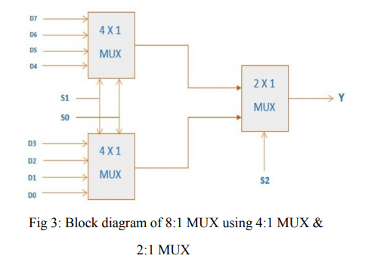
IMPLEMENTING 8:1 MUX using LOW ORDER MUX

Slide 32
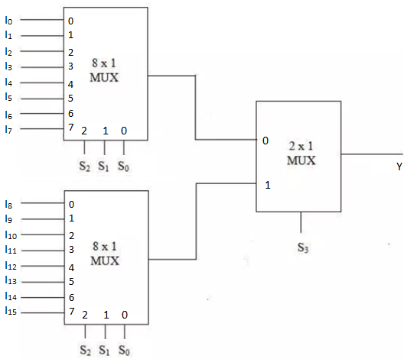
Example: Construct a 16 × 1 multiplexer with two 8 × 1 and one 2 × 1 multiplexers.

Slide 33
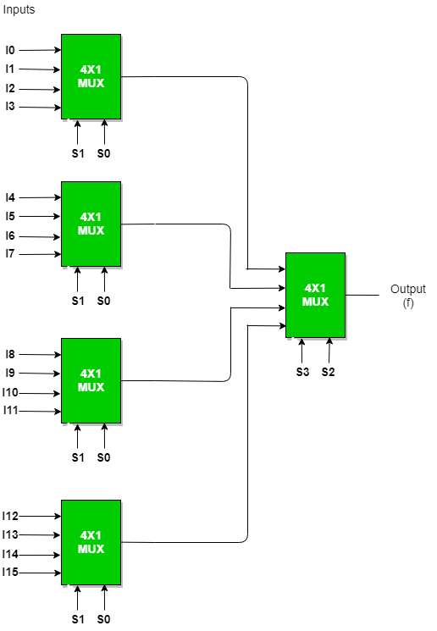
Example: Construct a 16 × 1 multiplexer with five 4 × 1 multiplexers.

Slide 34
De-multiplexers
DEMUX or De-Multiplexer is a combinational circuit that performs the reverse operation as compared to Multiplexer.
The DEMUX has 1 input and 2^{n} output lines. Here n signifies the selection line for a DEMUX.
As per the selection line value, the DEMUX input lines will be connected to the output.

Slide 35
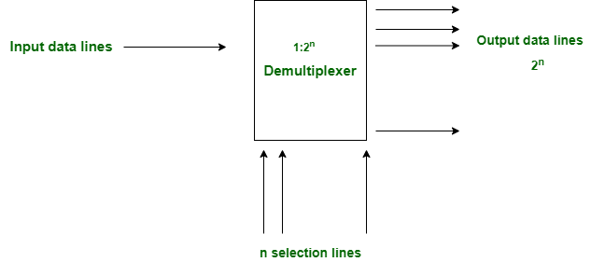

Slide 36


Typical Application of a DEMUX
Single Source
Selector
Multiple Destinations
B/W Laser
Printer
Fax
Machine
D₀
D₁
D₂
D₃
X
DEMUX
Color Inkjet
Printer
S₁ | S₀ | Selected Destination
0 | 0 | B/W Laser Printer
0 | 1 | Fax Machine
1 | 0 | Color Inkjet Printer
1 | 1 | Pen Plotter
Pen
Plotter
Notes:
This slide shows a typical application of a demultiplexer (in this case a 1-to-4 DEMUX). Ask students to share other common applications of DEMUXs.

Slide 37
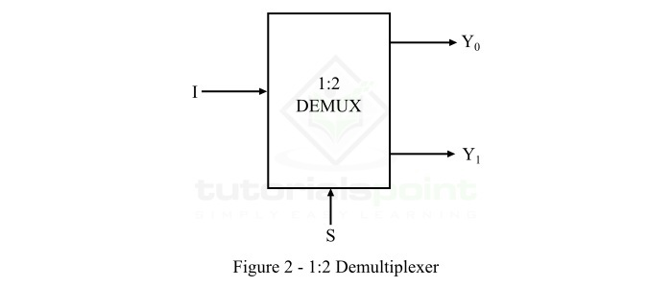
1×2 Demultiplexer
The 1×2 Demultiplexer consists of 1 input line (I), 1 select line (S), and 2 output lines (Y0 and Y1).

Slide 38
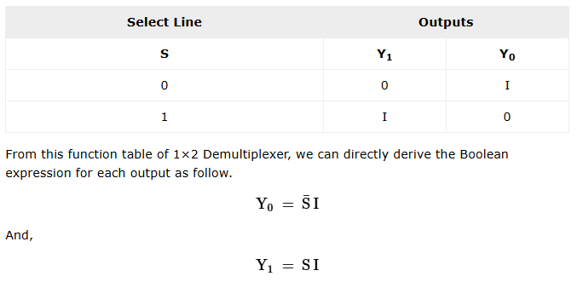
The operation of the 1×2 Demultiplexer can be analyzed with the help of its function table given below.

Slide 39
1X4 De-multiplexer
A 1x4 DEMUX has only one input which is denoted as I. There are two selection lines i.e. S1 and S0.
At last, the DEMUX has output lines including Y3, Y2, Y1 &Y0. The input data goes to any one of the four outputs at a given time for a particular combination of select lines.

Slide 40
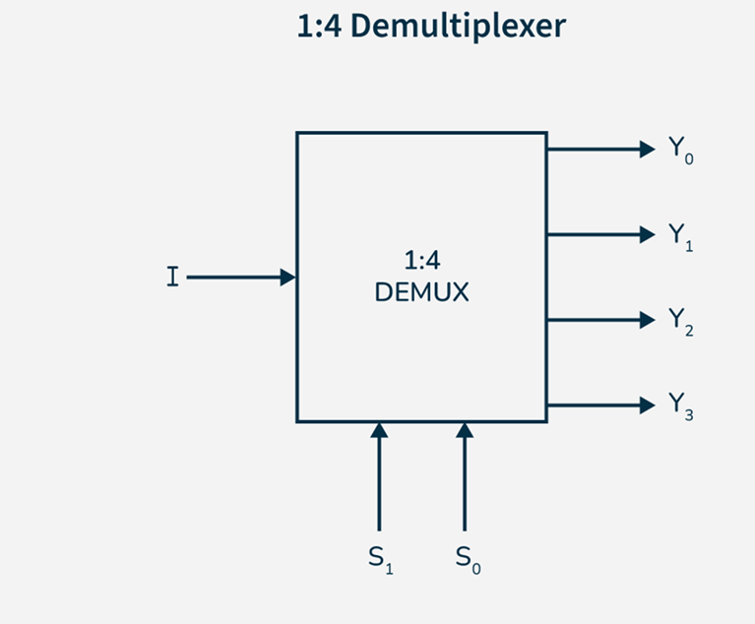
Here is the 1x4 DEMUX with diagram as mentioned below.

Slide 41
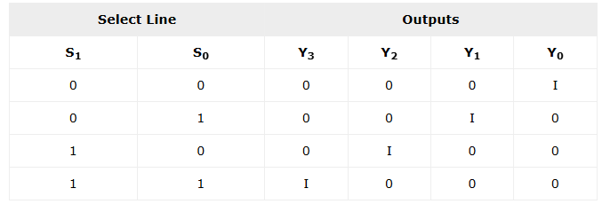
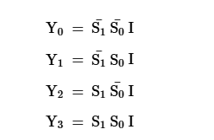
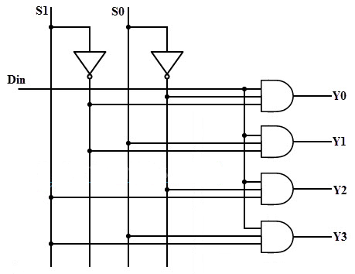
From this truth table of 1×4 Demultiplexer, we can directly write the Boolean expression for each output as follow.
Input line I or Din

Slide 42
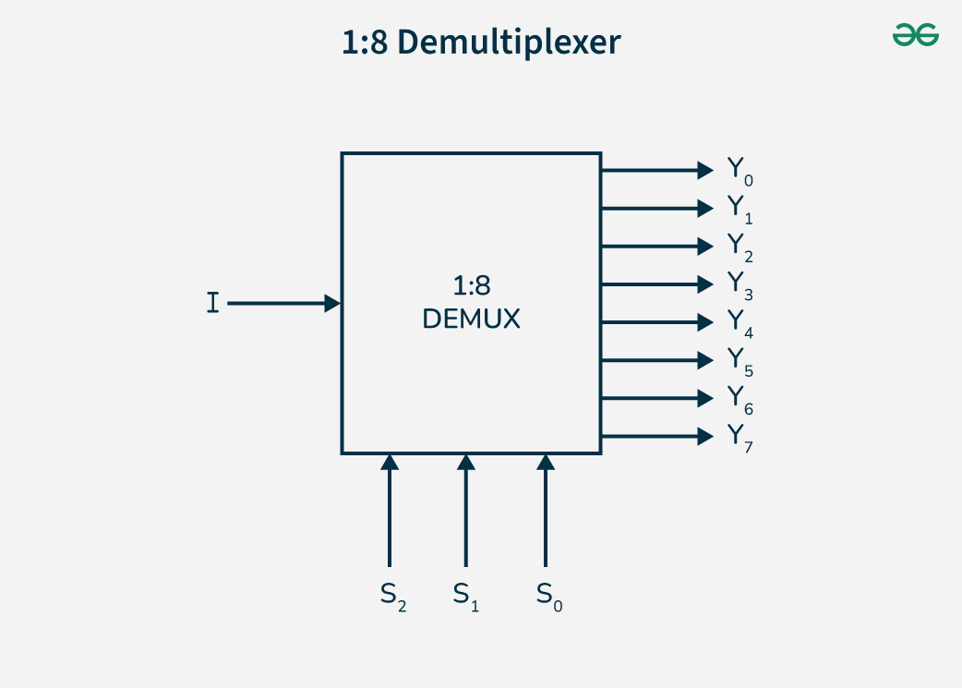
1X8 De-multiplexer

Slide 43
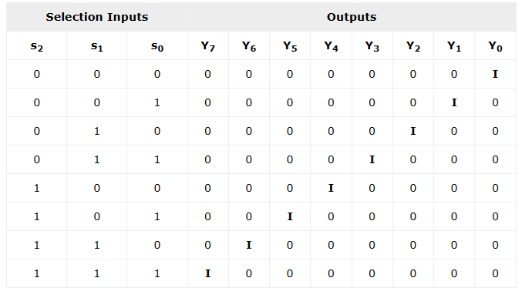

Slide 44
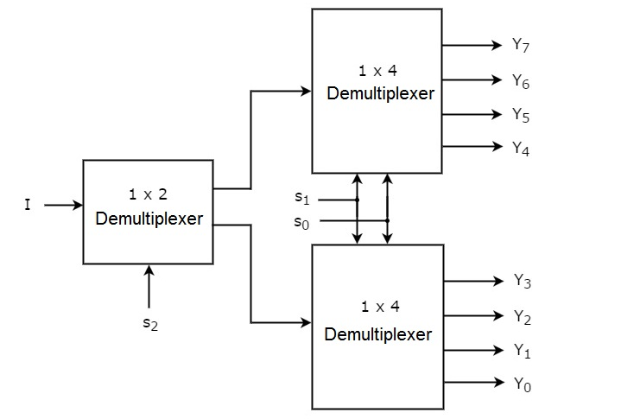
Implementation of Higher-order Demultiplexer
1×8 Demultiplexer

Slide 45
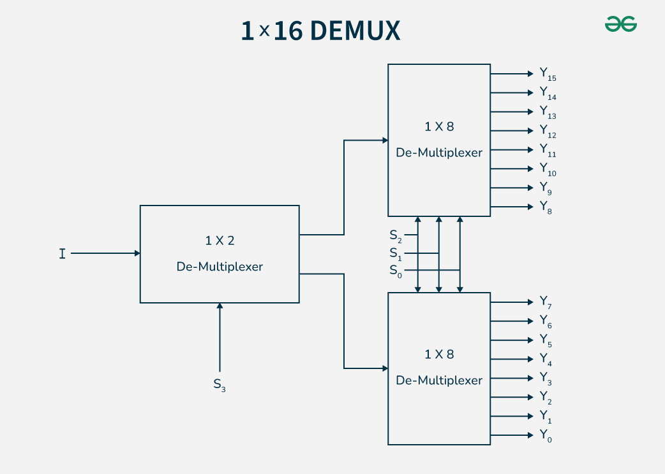
1X16 De-multiplexer
1X16 De-multiplexer using 1x2 and 1x8 DEMUX

Slide 46
Binary Multiplier
Multiplication of binary numbers is performed in the same way as multiplication of decimal numbers.
The multiplicand is multiplied by each bit of the multiplier, starting from the least significant bit.
Each such multiplication forms a partial product. Successive partial products are shifted one position to the left.
The final product is obtained from the sum of the partial products.

Slide 47
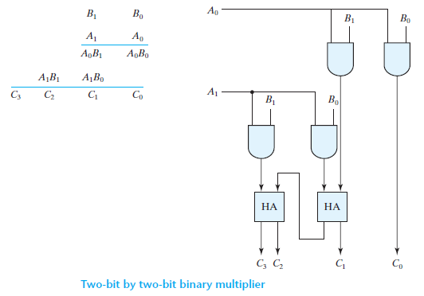
Consider the multiplication of two 2-bit numbers as shown in Fig.

Slide 48
The multiplicand bits are B₁ and B₀, the multiplier bits are A₁ and A₀, and the product is C₃C₂C₁C₀.
The first partial product is formed by multiplying B₁B₀ by A₀.
The multiplication of two bits such as A₀ and B₀ produces a 1 if both bits are 1; otherwise, it produces a 0. This is identical to an AND operation. Therefore, the partial product can be implemented with AND gates as shown in the diagram.

Slide 49
The second partial product is formed by multiplying B₁B₀ by A₁ and shifting one position to the left.
The two partial products are added with two half-adder (HA) circuits.
Usually, there are more bits in the partial products and it is necessary to use full adders to produce the sum of the partial products.

Slide 50
Note that the least significant bit of the product does not have to go through an adder, since it is formed by the output of the first AND gate.

Slide 51
A combinational circuit binary multiplier with more bits can be constructed in a similar fashion.
A bit of the multiplier is ANDed with each bit of the multiplicand in as many levels as there are bits in the multiplier.
The binary output in each level of AND gates is added with the partial product of the previous level to form a new partial product.
The last level produces the product.
For J multiplier bits and K multiplicand bits, we need (J × K) AND gates.

Slide 52
Encoders
An encoder is a combinational circuit which have maximum of “2^n" input lines and "n" output lines.
An encoder has 2^{n} input lines and n output lines.
The output lines, as an aggregate, generate the binary code corresponding to the input value.
2^{n}-to-n
Encoder
2^{n}
input
lines
n
output
lines
.
.
.
.

Slide 53
Types of Encoders
4 to 2 Encoder
8 to 3 Encoder (Octal Encoder)
Decimal to BCD Encoder

Slide 54
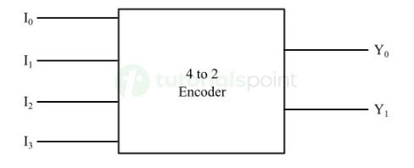
4 to 2 Encoder
A 4 to 2 Encoder is a type of encoder which has 4 (2²) input lines and 2 output lines. It produces an output code (i.e., convert input information into 2-bit format) depending on the combination of input lines.
The block diagram of a 4 to 2 Encoder is shown in the following figure.

Slide 55
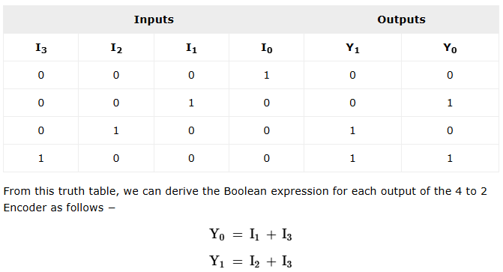

Slide 56
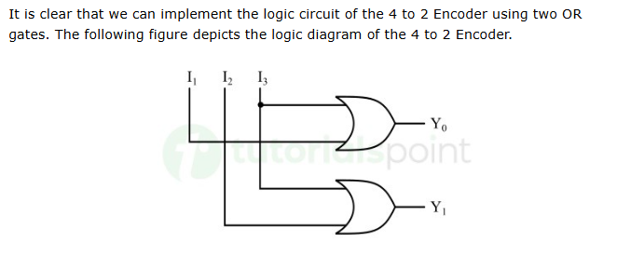

Slide 57
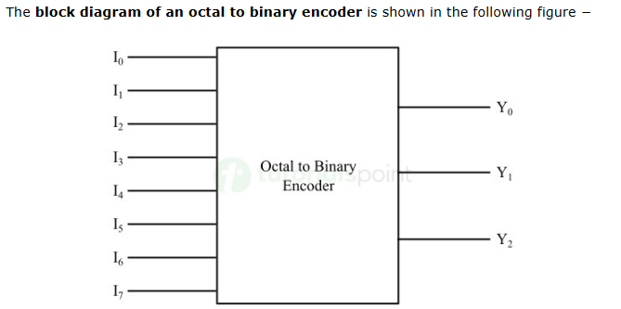
Octal-to-Binary Encoder
It has eight inputs (one for each of the octal digits) and three outputs that generate the corresponding binary number. it is also known as 8 to 3 Encoder.

Slide 58
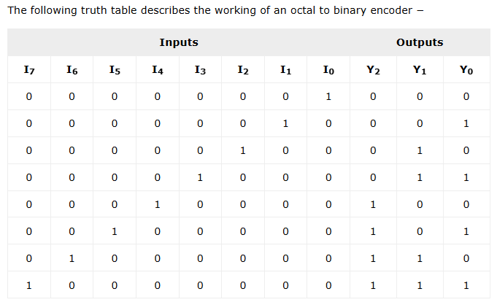

Slide 59
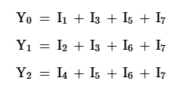
From the truth table, output Y0 is equal to 1 when the input octal digit is 1, 3, 5, or 7. Output Y1 is 1 for octal digits 2, 3, 6, or 7, and output Y2 is 1 for digits 4, 5, 6, or 7.
These conditions can be expressed by the following Boolean output functions:

Slide 60
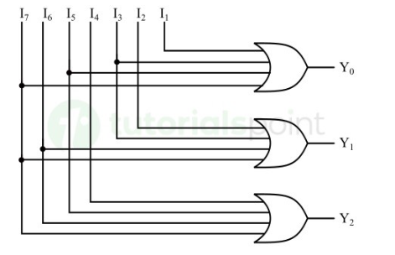
The encoder can be implemented with three OR gates.

Slide 61
There are two ambiguities associated with the design of a octal-to-binary encoder:
Only one input can be active at any given time. If two inputs are active simultaneously, the output produces an undefined combination.
To resolve this ambiguity, encoder circuits must establish an input priority to ensure that only one input is encoded.

Slide 62
Priority Encoder
A priority encoder is an encoder circuit that includes the priority function.
The operation of the priority encoder is such that if two or more inputs are equal to 1 at the same time, the input having the highest priority will take precedence.

Slide 63
Four-input Priority Encoder
It has three outputs designated by A, B, and V. Where, A and B are the ordinary outputs and V is the output that acts as a valid bit indicator.
This third output V is set to 1 when one or more inputs are equal to 1.
In the case, when all the inputs to the encoder are equal to 0, there is no any valid input, and thus the output V is set to 0.
The other two outputs, i.e. A and B of the encoder are not determined when V is equal to 0.
Therefore, when, V is equal to 0, the outputs A and B are specified as "dont care conditions".

Slide 64
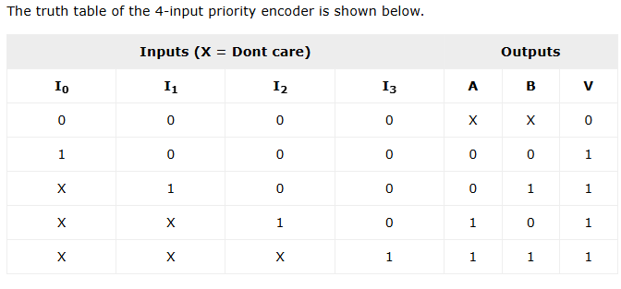

Slide 65
From this truth table, it can be observed that the higher the subscript number of the input, the higher the priority of the input.
Thus, the input I₃ has the highest priority. Therefore, regardless of the values of other inputs, when the input I₃ is equal to 1, the output for AB is 11, i.e. 3.
The input I₂ has the next lower priority, and then I₁, and finally I₀ has the lowest priority.
We can write the Boolean expression for outputs A, B, and V from the above table as follows,

Slide 66



Slide 67

Decoders
A decoder is a combinational circuit that converts binary information from n input lines to a maximum of 2^{n} unique output lines.
If the n-bit coded information has unused combinations, the decoder may have fewer than 2^{n} outputs.

Slide 68
The decoders presented here are called n-to-m-line decoders, where m ≤ 2^{n}.
Their purpose is to generate the 2^{n} (or fewer) minterms of n input variables.
Each combination of inputs will assert a unique output.
The name decoder is also used in conjunction with other code converters, such as a BCD-to-seven-segment decoder.

Slide 69
2-to-4-Line Decoder
In 2-to-4-line decoder circuit, the two inputs are decoded into four outputs, each representing one of the minterms of the two input variables.
The two inputs are represented by A and B and outputs are represented by D₀, D₁, D₂ and D₃.

Slide 70




Slide 71
3-to-8-Line Decoder
In 3-to-8-line decoder circuit, the three inputs are decoded into eight outputs, each representing one of the minterms of the three input variables.
A particular application of this decoder is binary-to-octal conversion. The input variables represent a binary number, and the outputs represent the eight digits of a number in the octal number system.
However, a 3-to-8-line decoder can be used for decoding any three-bit code to provide eight outputs, one for each element of the code.

Slide 72



Slide 73


Slide 74
Decoders with Enable Inputs
Generally, decoders have the “enable” input.
The enable input performs no logical operation, but is only responsible for making the decoder active or inactive.
If the enable “E”
  is zero, then all outputs are zero regardless of the input values.
  is one, then the decoder performs its normal operation.

Slide 75
Decoders with enable inputs can be connected together to form a larger decoder circuit.
For example, consider the 2-to-4 line decoder with enable input.
If enable E is zero, then all outputs of the decoder will be zeros, regardless of the values of A and B.
However, if E is one, then the decoder will perform its normal operation, as shown in the truth table.

Slide 76




Slide 77
Combinational Logic Implementation
Example: A combinational circuit is specified by the following three Boolean functions:
F₁(A, B, C) = ∑(1, 4, 6)
F₂(A, B, C) = ∑(3, 5)
F₃(A, B, C) = ∑(2, 4, 6, 7)
Implement the circuit with a decoder.

Slide 78


